Slide 1
NII-VN group Seminar
October 10th, 2016
National Institute of Informatics - Tokyo, Japan

Slide 2
Content
NII-Vietnamese community activities

Slide 3
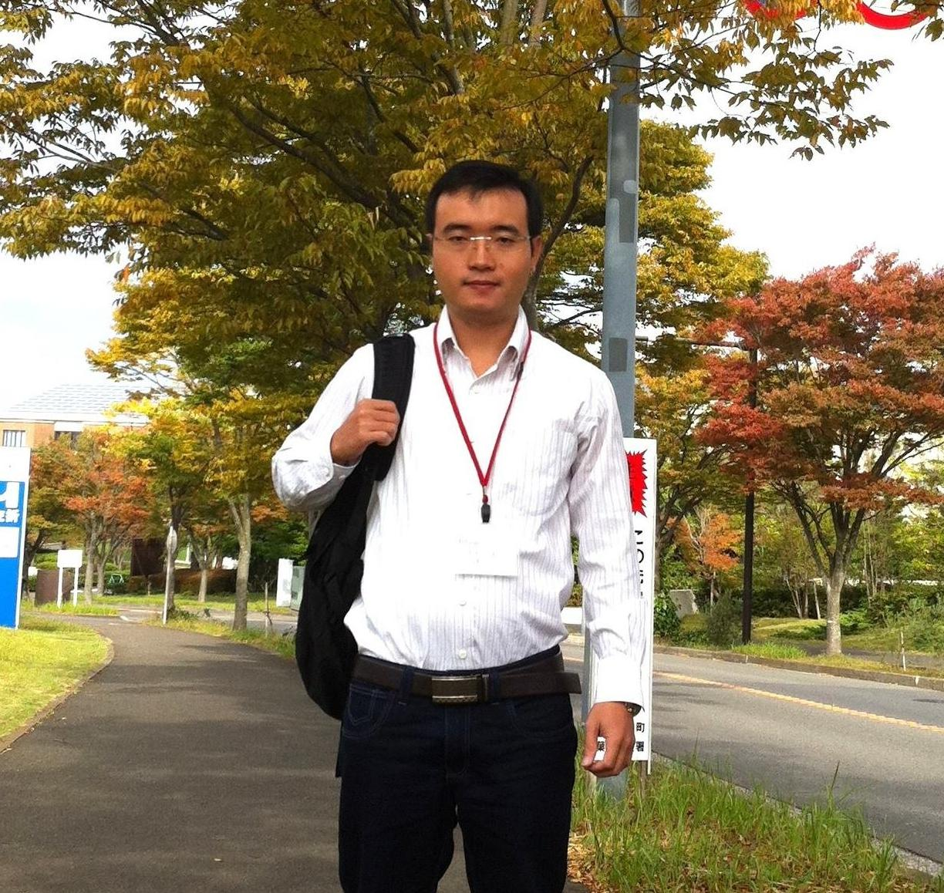
Phan Xuân Thiện
-2002-2005: Hue University of Science (Khối Chuyên Toán)
-2005-2010: B.E, HCMUT (ĐHBK TP. HCM)
-2010-2012: M.Sc, HCMUT
- 2012: Internship - University of Applied Sciences of Western Switzerland (Switzerland), Prof. Pierre Kuonen Lab
-2013-2014: Internship - NII, Prof. Shigeki Yamada Lab
-2014 - … : Lecturer at UIT (ĐH CNTT - ĐHQG TP.HCM)
-2014 - Now: PhD candidate, SOKENDAI-NII, Kensuke Fukuda Lab (MEXT scholarship)
Research interests:
Software-defined networking (SDN)
Network measurement and analysis, wireless/ad-hoc network
Intrusion/anomaly detection
Contact: thien@nii.ac.jp / xuanthiencs@gmail.com / skype: xuanthien.phan
*** “Together we move forward!” ***

Slide 4

NII-Vietnamese community activities
Over 180 members, ~ 20 – 25 onsite at NII (PhD, Post-doc, interns, Assist. Prof., Assoc. Prof.)
Academic:
Seminars/lunch seminars
Classes/workshops: paper reading/writing skills, presentations,...
Information sharing: PhD scholarship, Post-doc positions, internship, job opportunities,...
Hangout:
Hiking trips, climbing mountains (Fuji, Takao, Okutama,...)
Bonenkai, Shinenkai (December, January)
Hanami (April), Hanabi (June, July,...)
Facilities:
Group email (NII-Vietnamese@googlegroup.com), Facebook

Slide 5
NII-Vietnamese community activities
Research topics
Computer networking
Software-defined networks (SDN)
AI
Natural language processing
Image/video processing
...

Slide 6
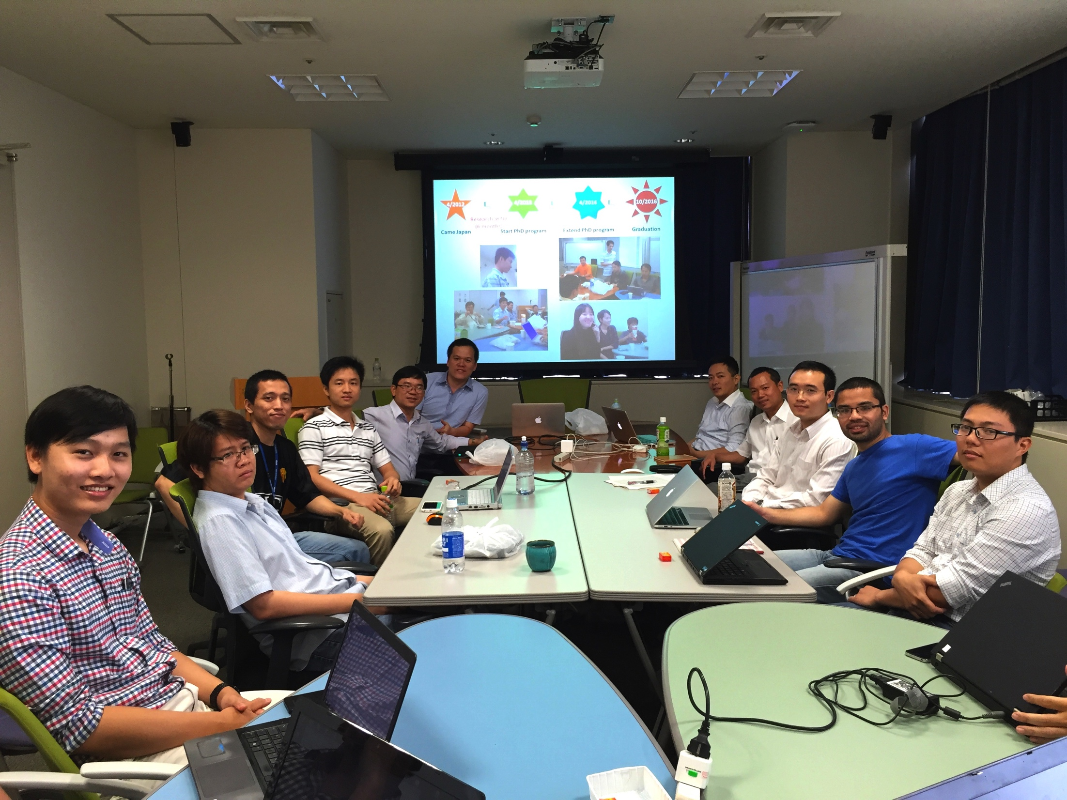
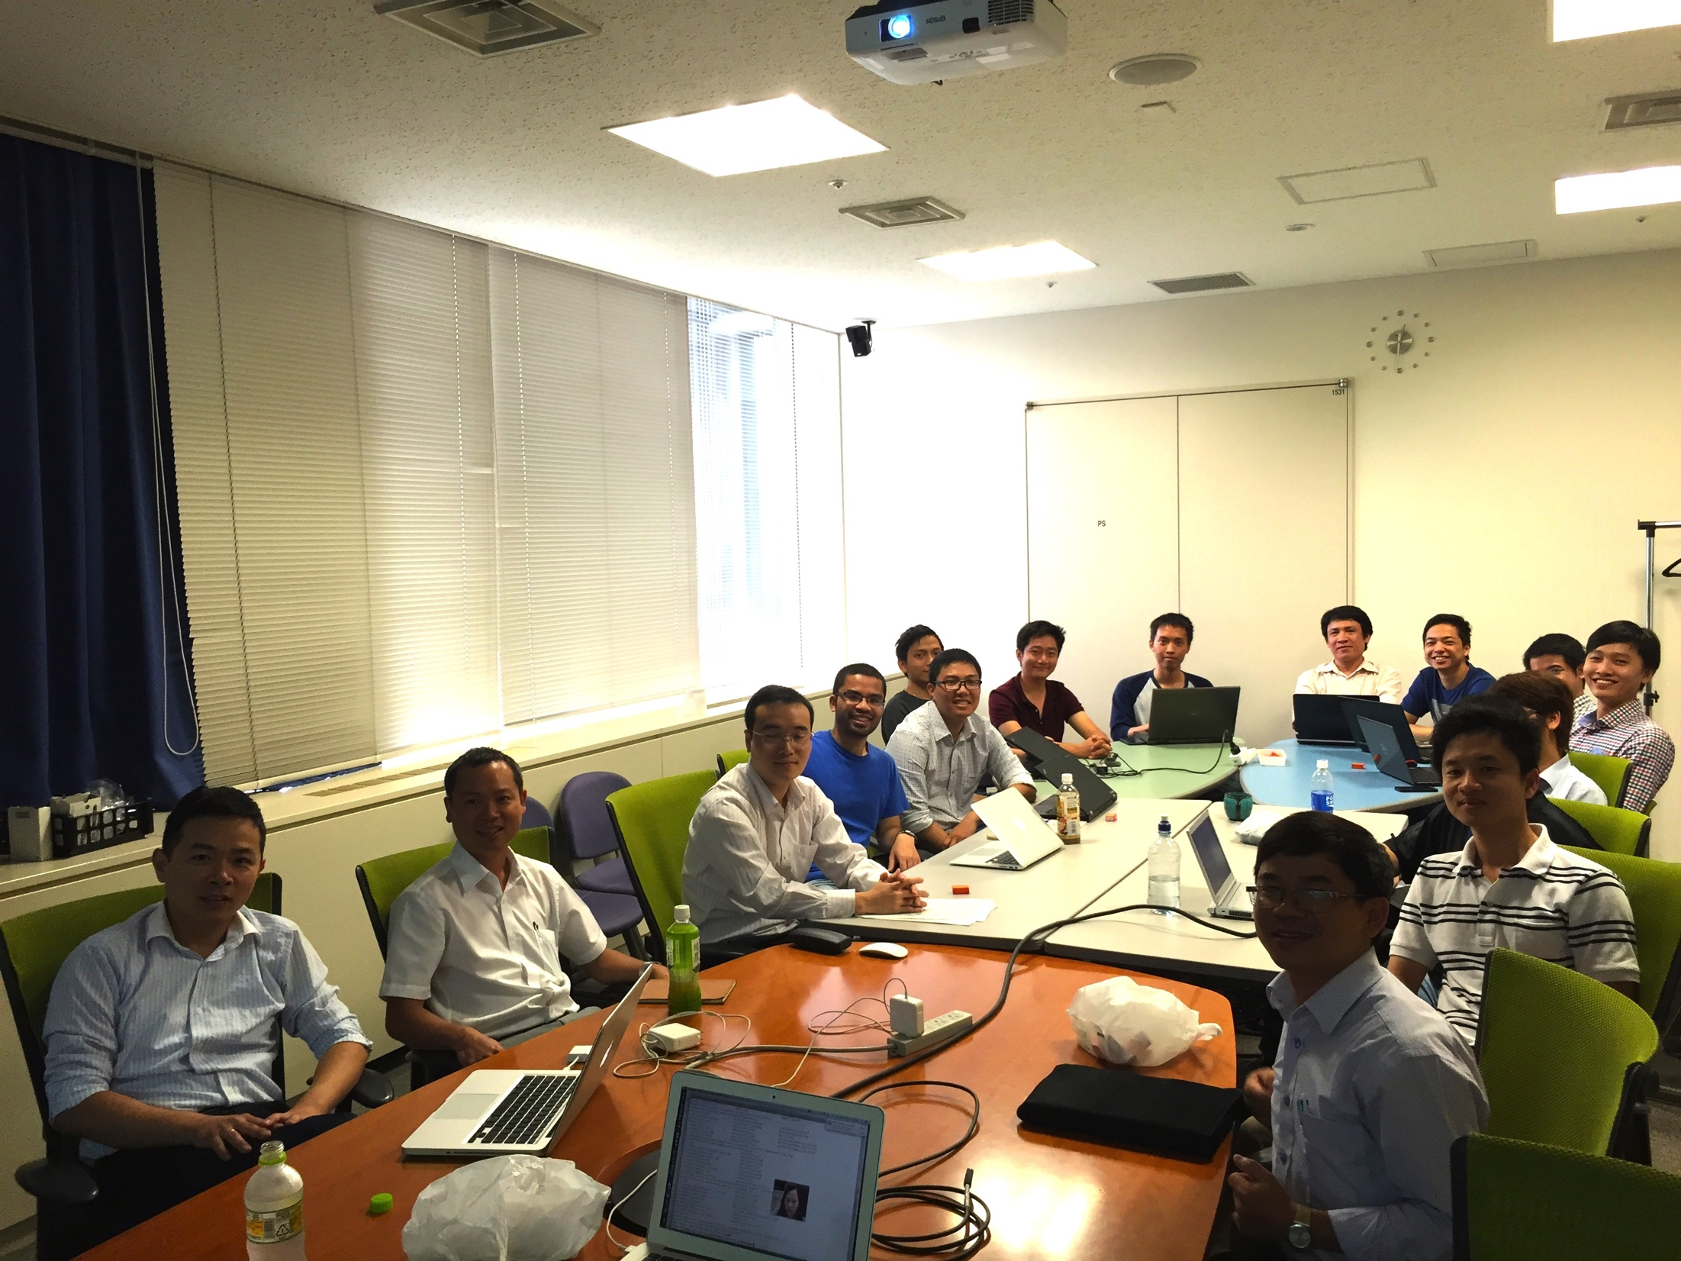
Seminars

Slide 7
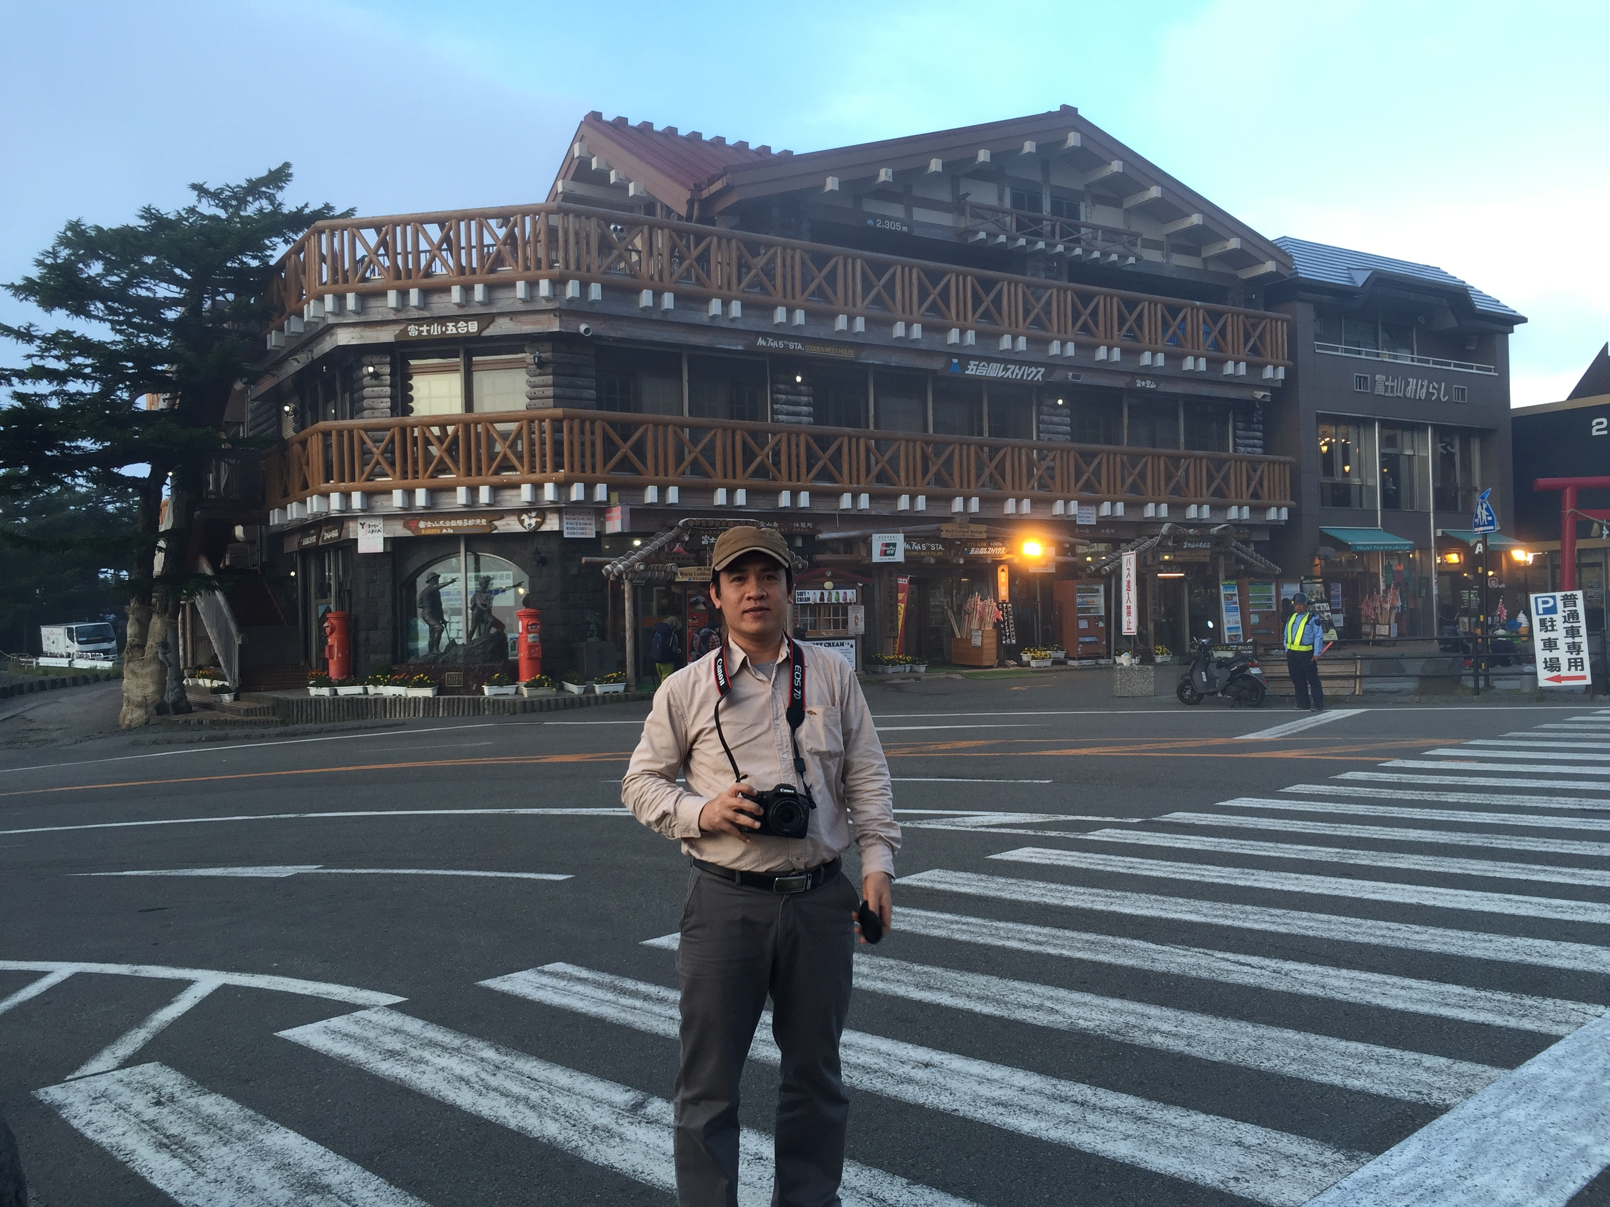
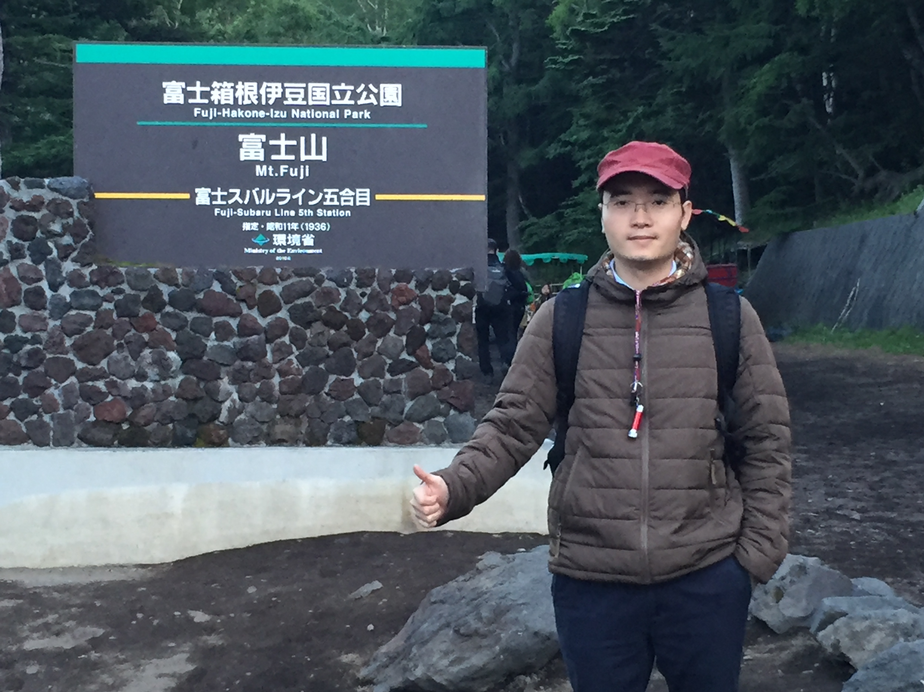

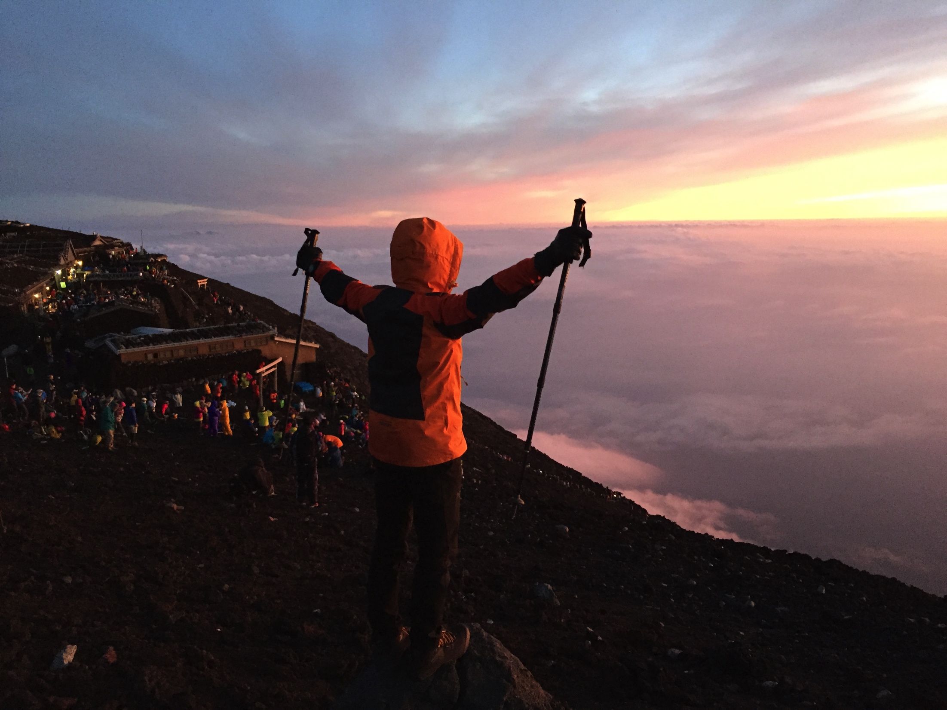
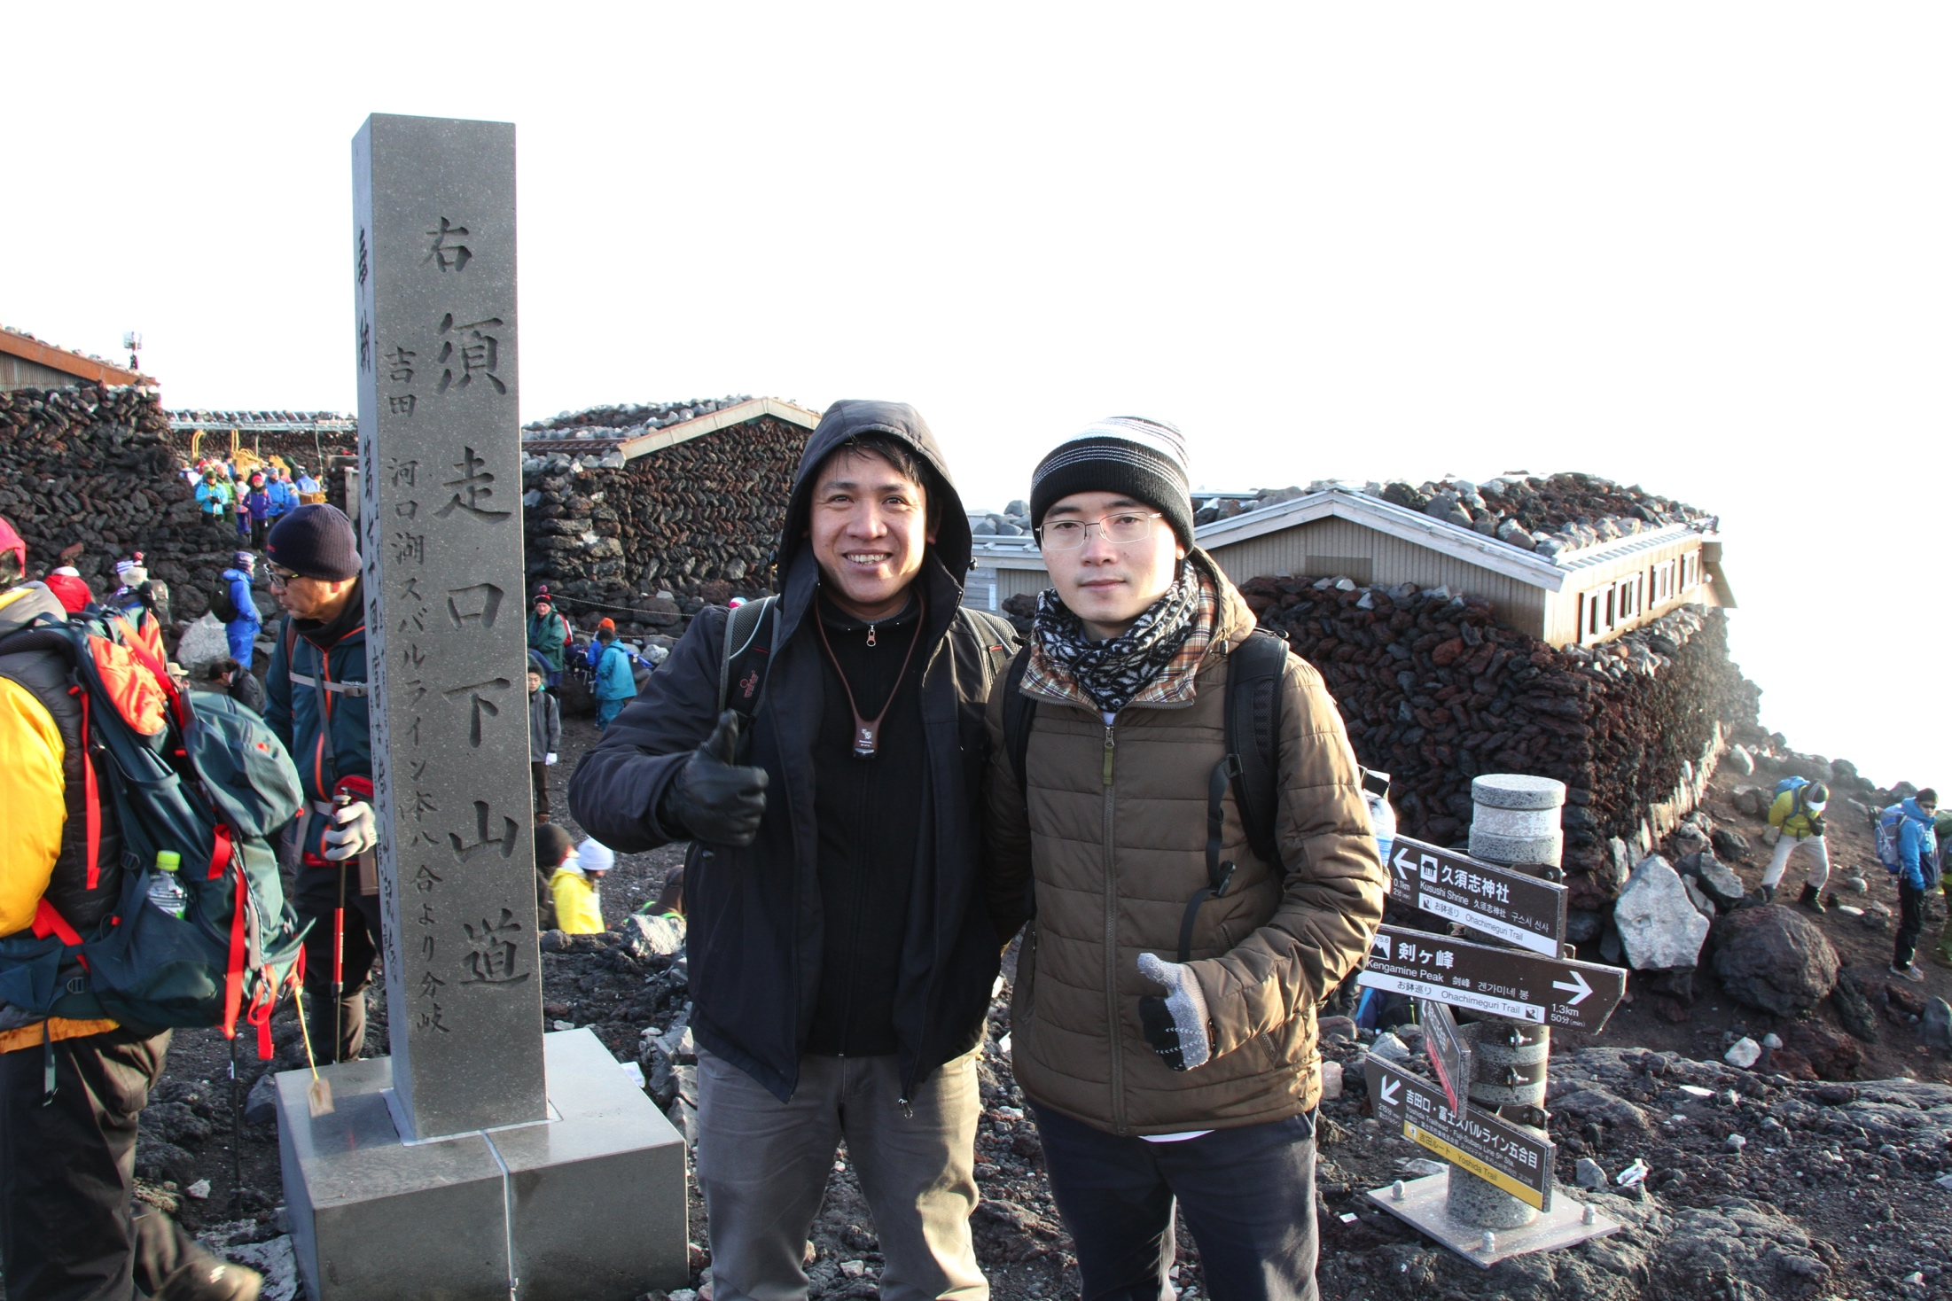

Hiking/climbing trips

Slide 8
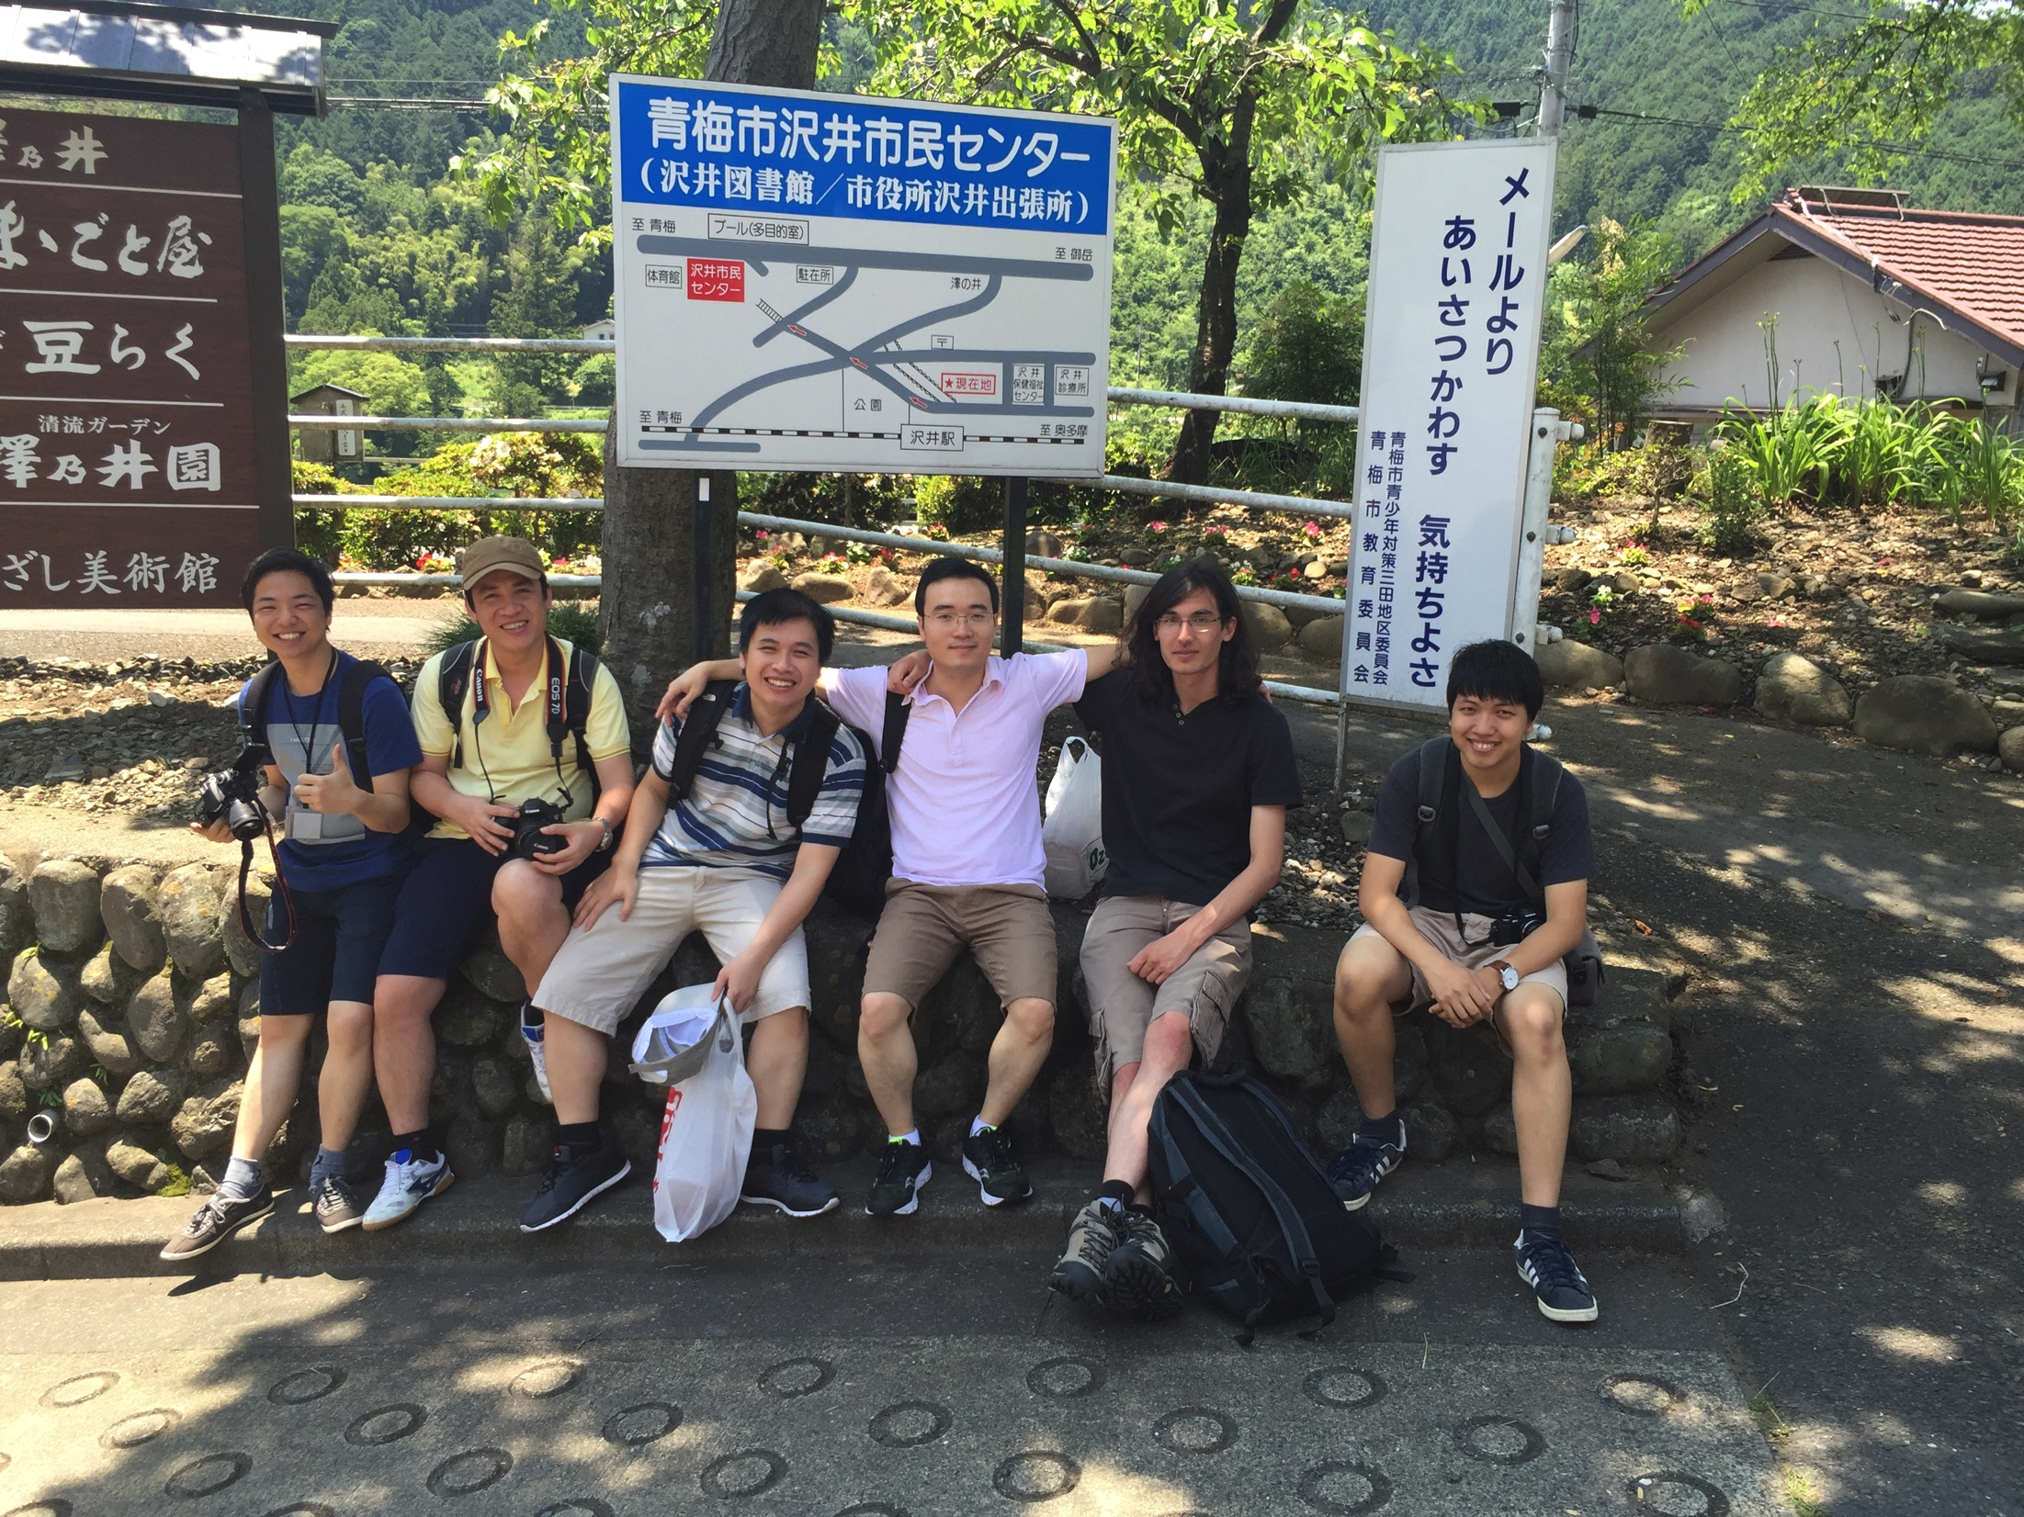
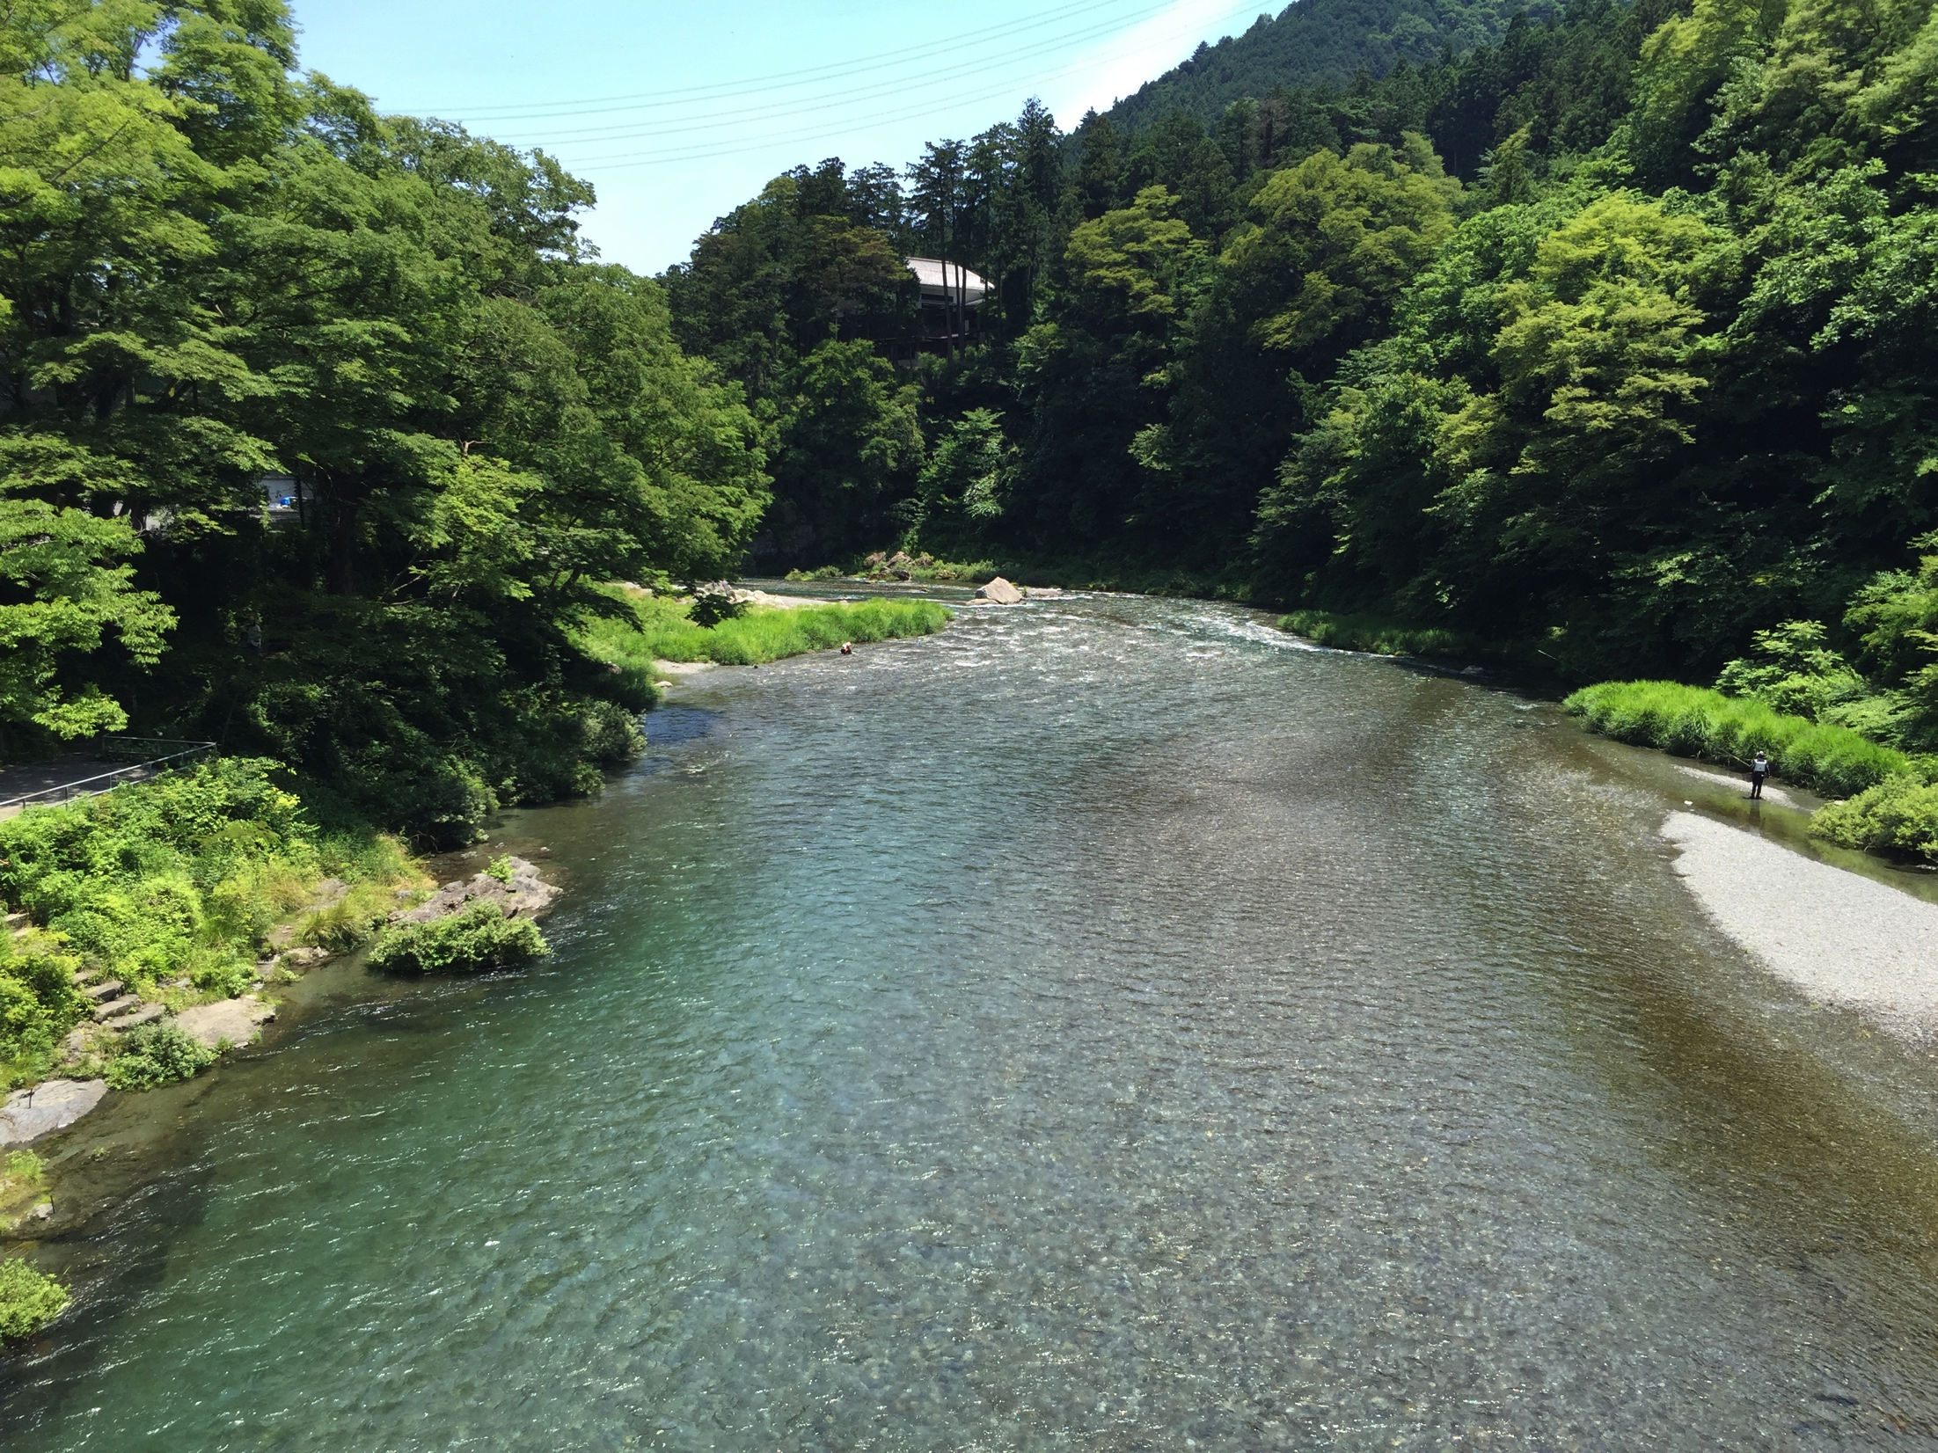
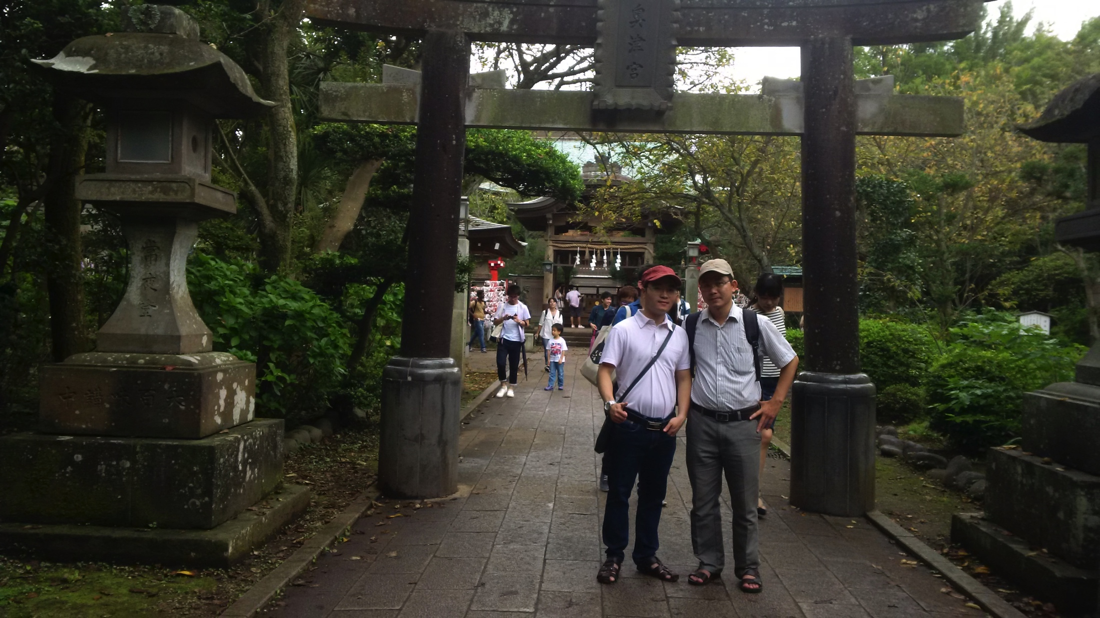
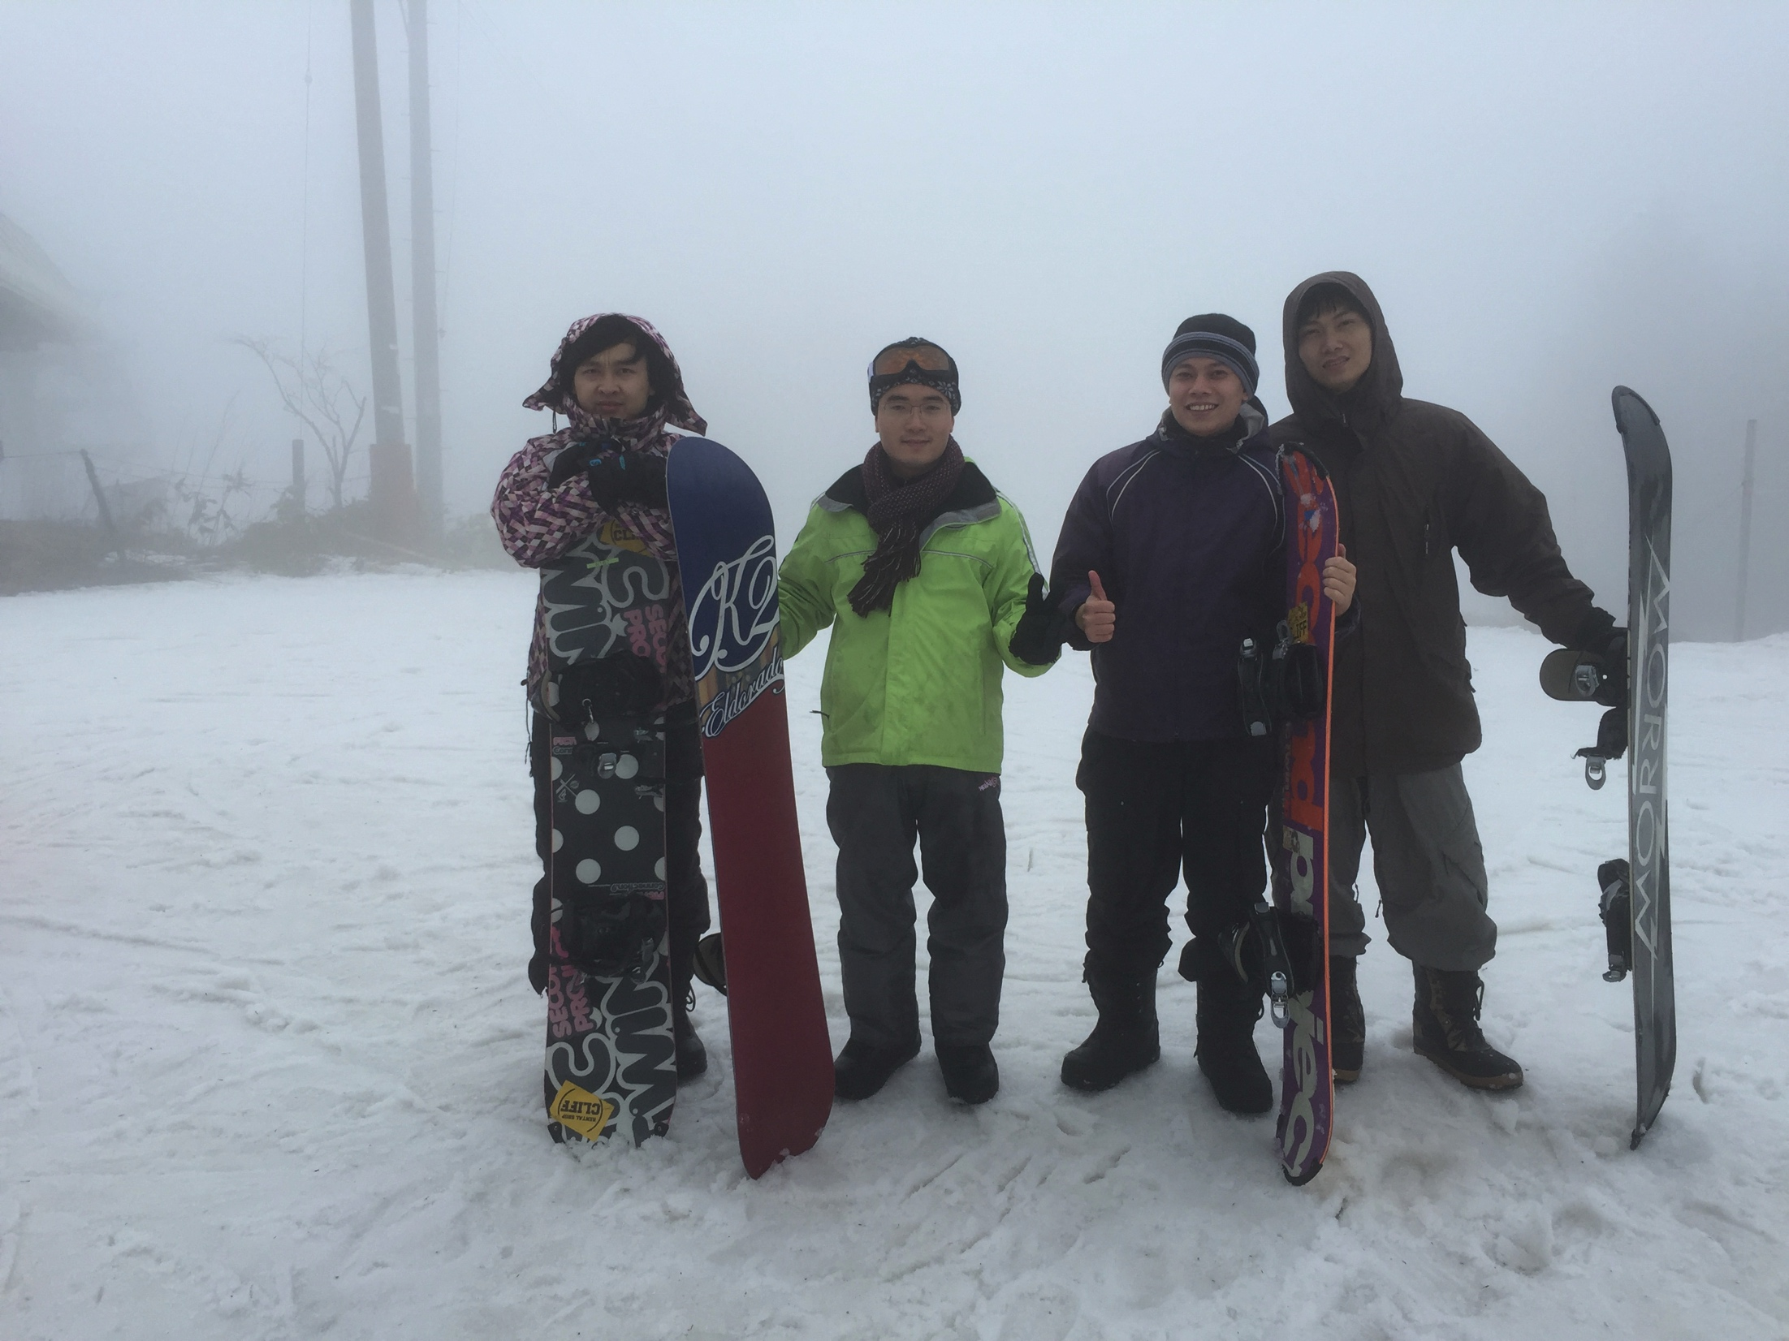
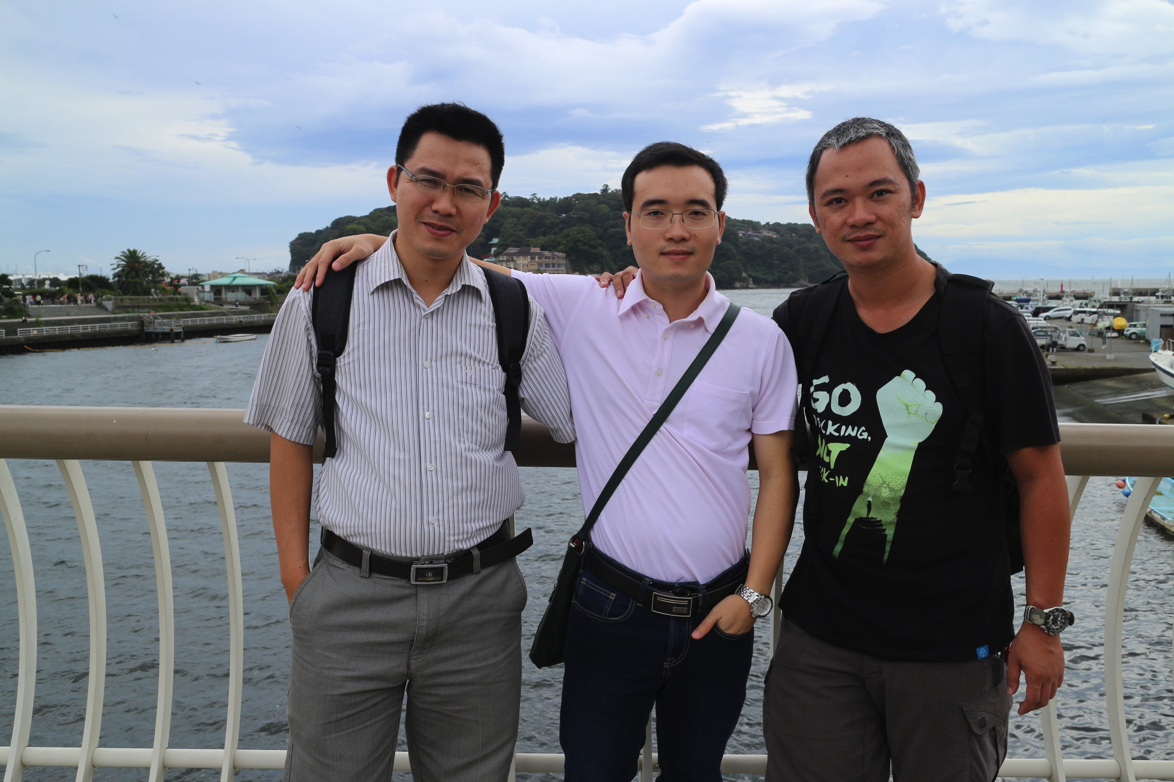
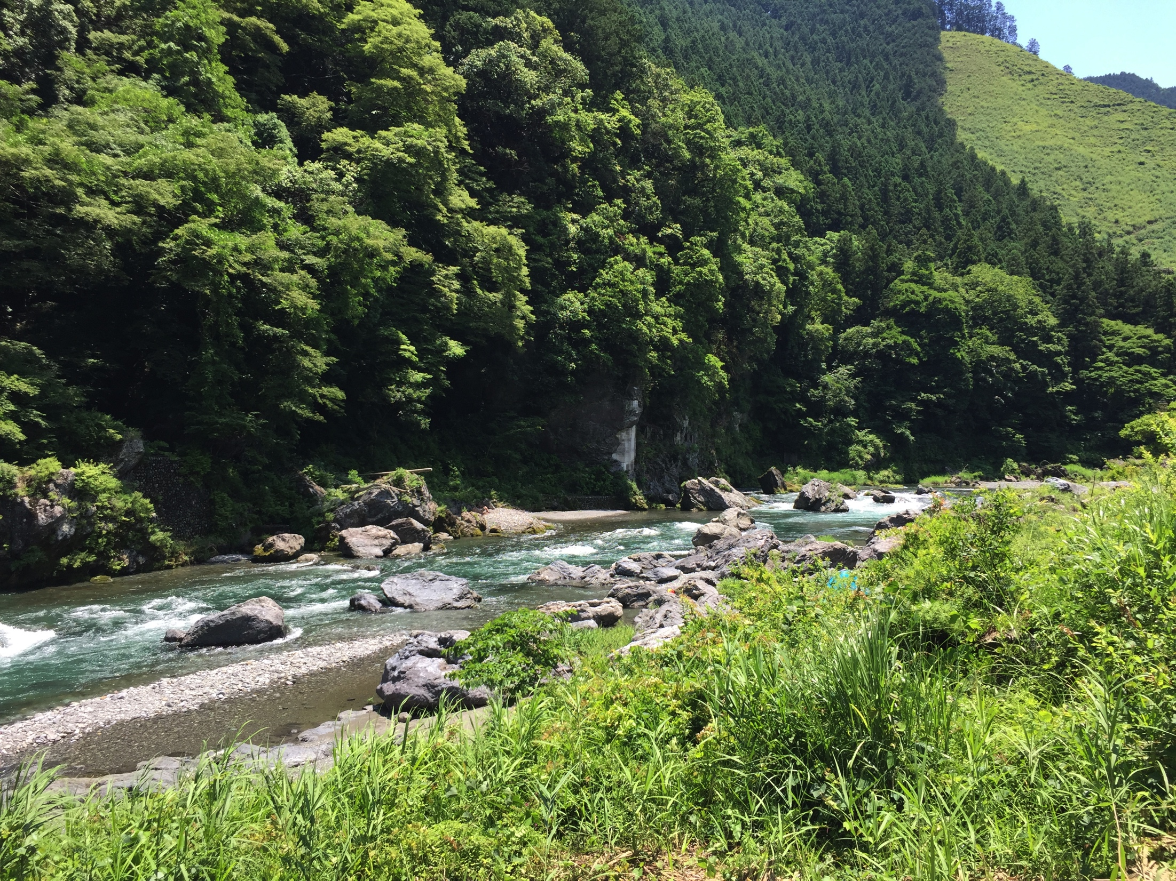
Hiking/climbing trips

Slide 9
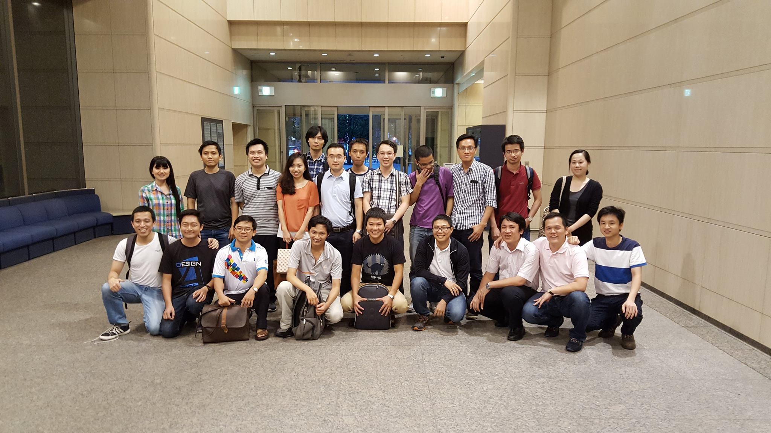
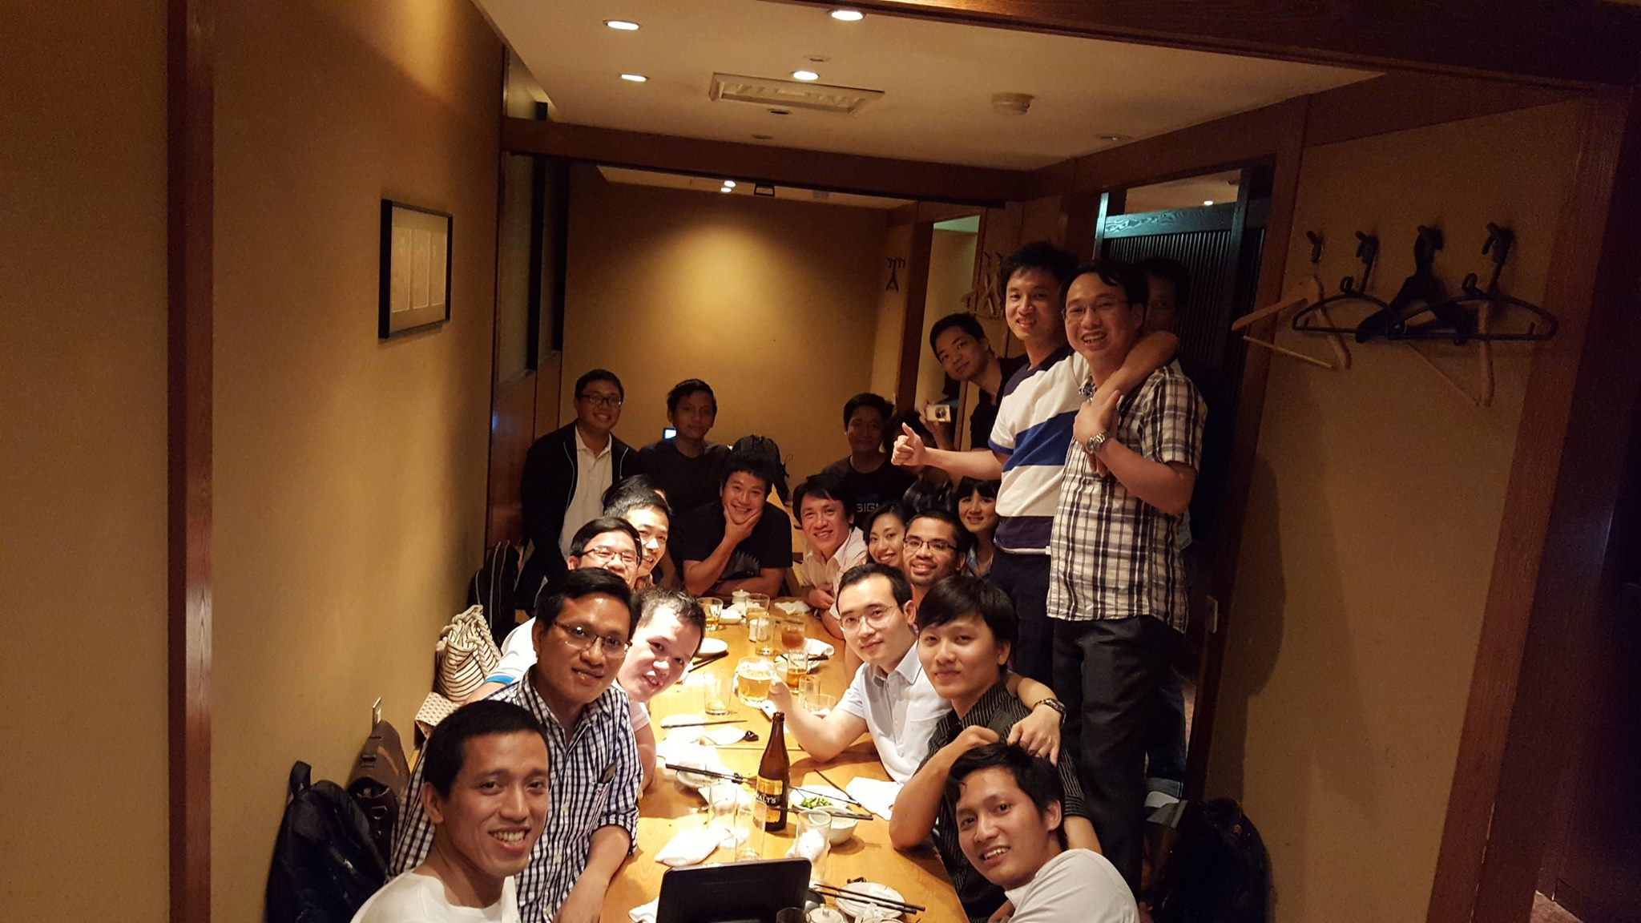
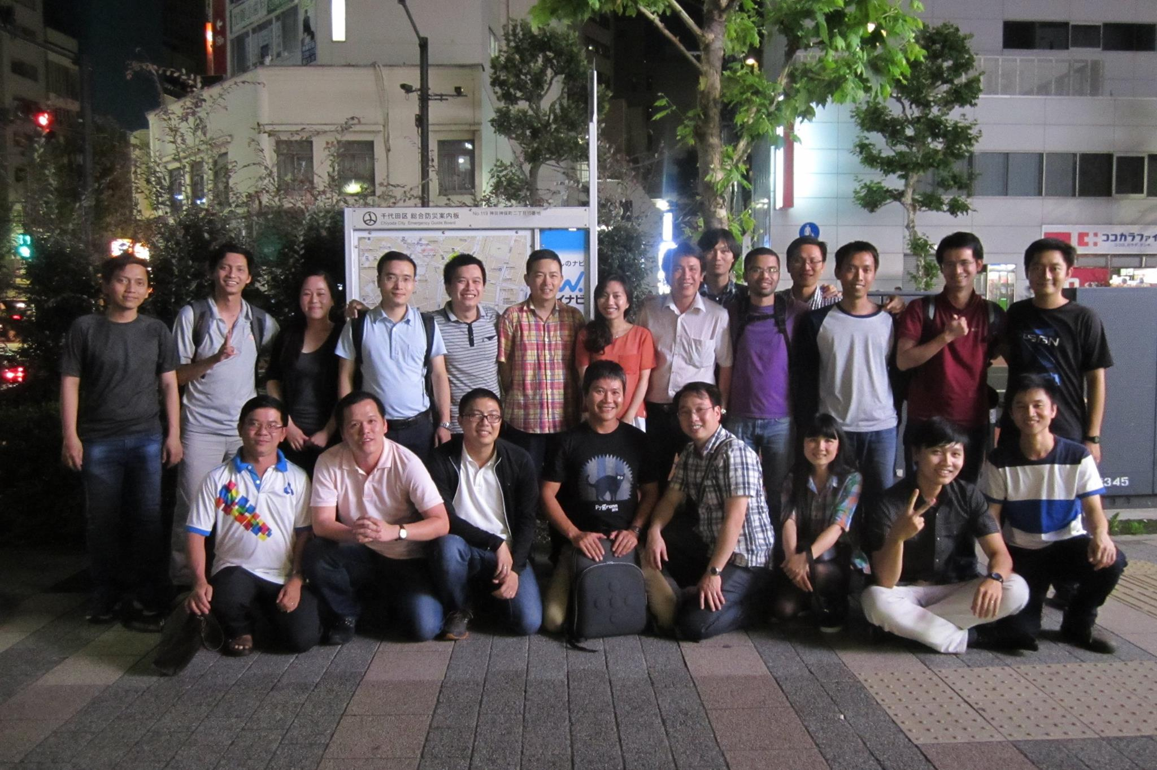
Bonenkai/Shinenkai/parties

Slide 10
NII-Vietnamese community activities
Some expectations for members:
Open-minded, good relationship with all other members
Join organized activities, have fun
Share information/experiences
Be confident, have good working process
Let’s be a COMMUNITY, not a basket of separated people

Slide 11
Regular seminars
Academic seminar:
1/month, on the first half of a month
share academic knowledge (research topics, hot topics, general knowledge of a specific research field,...)
General/research experiences: project planning, time management, paper writing, presentation at conferences
Slides prepared
‘the more you share, the more you get’
Cafe/lunch seminar:
Friendly, 1/month, on the second half of a month
Prepare for academic seminar
experiences/talks share directly
No prepared slides needed

Slide 12
Plan for regular seminars
Goal:
Make a community sharing knowledge/experiences
Get members closer, support together in intern/PhD progress
keep good relationship for future collaboration
Get REAL benefit

Slide 13
Planning for an efficient Lab meeting ?
*My practical case
Why?
When?
How?
Meeting agenda
Meeting minutes
Research notes
Examples

Slide 14
Meeting agenda
What?
“A list of meeting activities in the order in which they are to be taken up, beginning with the call to order and ending with adjournment. It usually includes one or more specific items of business to be acted upon. It may, but is not required to, include specific times for one or more activities.” (wikipedia)
Why?
“An organized meeting needs a well-written agenda. Don't let your meeting become the over-long, inefficient slog into which so many meetings seem to devolve. By sticking to a detailed, yet flexible agenda, you can keep your meeting streamlined and focused, ensuring that you meet all of your goals for your meeting in the shortest amount of time” (wikihow)
When?
1 or several days before meeting

Slide 15
Meeting agenda
How?
MS word (.doc), slides,...
Give a title, include “who, where, when” info in header
Outline meeting objectives
Discussion topics: problems, ideas,...
Time schedule for each section (but be flexible)
Discussion/Q&A
(http://www.wikihow.com/Write-an-Agenda-for-a-Meeting)
Agenda should be distributed before a meeting => prof. has time to review what you want to discuss, think about problems and give advices/comments on your problems

Slide 16
Meeting agenda
Make your own meeting agenda temple:
Objectives
Discussion issues
Problem 1
Problem 2
...
Suggestion
Next meeting (date, expected objectives)
A practical example (some of my meeting agendas)

Slide 17
Meeting minutes
What?
“Minutes, also known as protocols or, informally, notes, are the instant written record of a meeting or hearing. They typically describe the events of the meeting and may include a list of attendees, a statement of the issues considered by the participants, and related responses or decisions for the issues” (wikipedia)
Why?
Make clear what decisions made
Next steps planned
Track progress
When?
1 or several days after meeting

Slide 18
Meeting minutes
How?
Pre-planning: meeting agenda outline,

Slide 19
Research notes
A (detailed) description of ideas agreed in a meeting
Why?
Make clear every detail of ideas (include images, descriptions,...)
Can be reused in later steps of research progress (write paper,...)
Easily track idea flows/working progress
How?
Note a goal of ideas/notes
Write down every aspects of ideas/proposed solutions/problems
Include images, description text, flow charts, plots,...
An example (some of my research notes)

Slide 20
Meeting agenda
When?
1 day before meeting
H
A
E

Slide 21
Q&A
Notes:
Use a section header for each of the topics, so there is a clear transition to the audience.

